Slide 1
Exploratory Data Analysis

Slide 2
agenda
Explore the Dataset
Data Analysis: Univariate
Data Analysis: Bivariate

Slide 3

Explore the dataset

Slide 4
Explore the dataset
Understand the available variables
Clean the dataset
Prepare the dataset

Slide 5

Understand the available variables
HeartDiseaseorAttack
HighBP
HighChol
CholCheck
BMI
Smoker
Stroke
Diabetes
PhysActivity
Fruits
Veggies
12. HvyAlcoholConsump
13. AnyHealthcare
14. NoDocbcCost
15. GenHlth
16. MentHlth
17. PhysHlth
18. DiffWalk
19. Sex
20. Age
21. Education
22. Income

Slide 6
Clean the dataset
Clean the dataset by converting variables to appropriate data types.
Column Name | Data Type
HeartDiseaseorAttack | category
HighBP | category
HighChol | category
CholCheck | category
BMI | int64
Smoker | category
Stroke | category
Diabetes | category
PhysActivity | category
Fruits | category
Veggies | category
HvyAlcoholConsump | category

Slide 7
Clean the dataset
Clean the dataset by converting variables to appropriate data types.
Column Name | Data Type
AnyHealthcare | category
NoDocbcCost | category
GenHlth | int64
MentHlth | int64
PhysHlth | int64
DiffWalk | category
Sex | category
Age | int64
Education | category
Income | category

Slide 8

Prepare the dataset
Removing duplicates.
Filling null values.
Remove any irrelevant columns.
The Dataset does not contain duplicates.
It does not contain null values.
All columns are relevant to predict target variables.

Slide 9


Slide 10
Data Analysis: Univariate
Examine Distributions of Individual Variables
Investigate Prevalence of Health Conditions
Analyze Distribution of Heart Disease (Target Variable)

Slide 11

Examine Distributions of Individual Variables
Key Variables are
HeartDiseaseorAttack
HighBP
HighChol
BMI
Smoker
Stroke
Diabetes
PhysActivity
Fruits
Veggies
HvyAlcoholConsump
Sex
Age

Slide 12
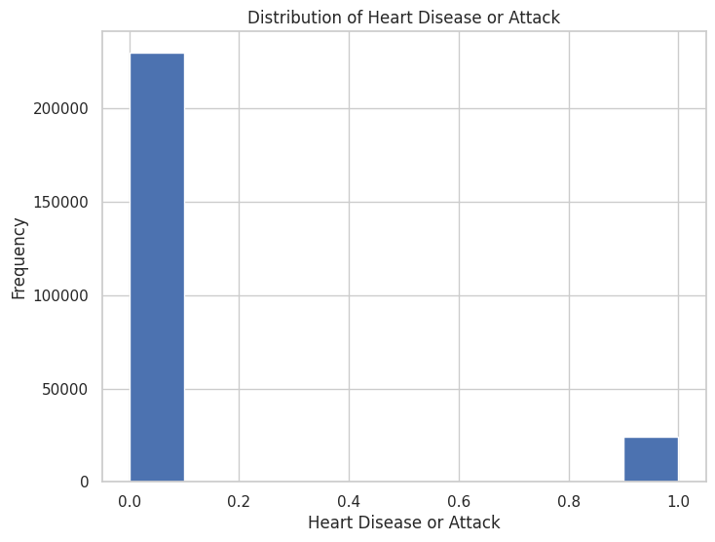
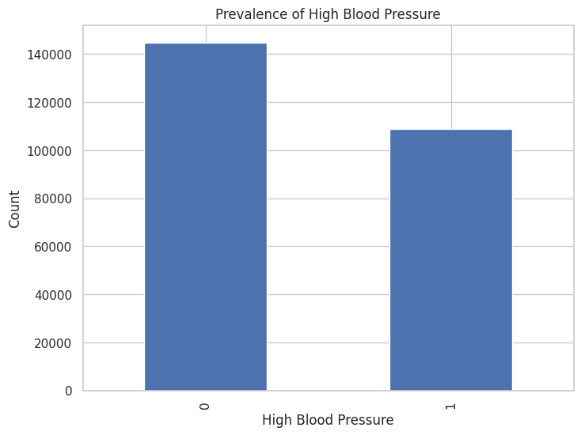
Examine Distributions of Individual Variables
Heart Disease :
The dataset has a much higher number of individuals without heart disease compared to those with it.
This imbalance may require addressing in analysis and modeling.
2. High Blood Pressure :
There are more individuals with high blood pressure than those without it, though the numbers are relatively close.
High blood pressure is a common condition among the population in this dataset.

Slide 13

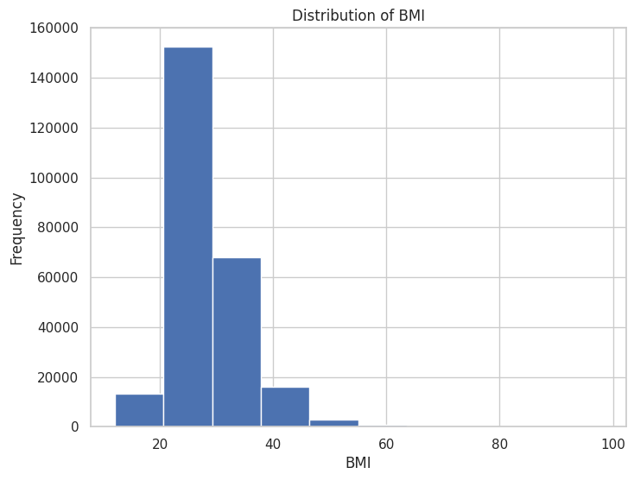
Examine Distributions of Individual Variables
3. High cholesterol:
High Cholesterol is prevalent among a significant portion of the population.
The counts are close to those for high blood pressure, suggesting both conditions are common.
4. Smoking:
There are more non-smokers than smokers in the dataset.
Smoking is a common risk factor, but the dataset shows a larger portion of non-smokers.

Slide 14
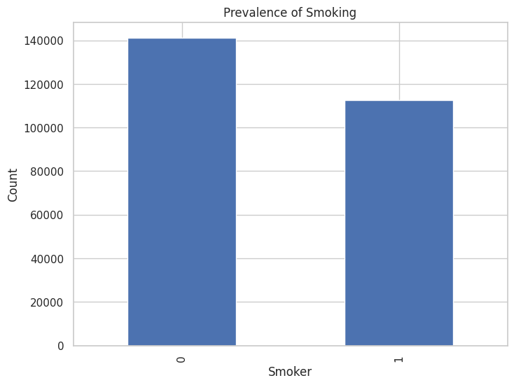
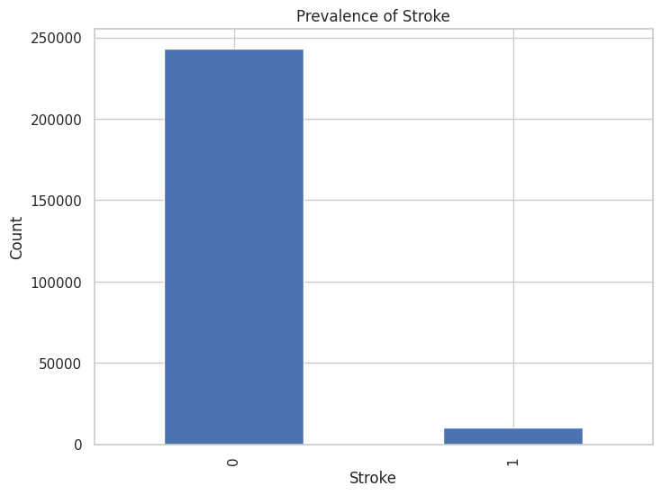
Examine Distributions of Individual Variables
5. BMI:
The highest frequency of BMI values occurs around 20-30, suggesting this is the most common BMI range in the dataset. There's a substantial number of individuals with BMI values between 25-30 (overweight range) and above 30 (obese range), which could be significant.
6. Stroke:
Stroke is relatively rare in the dataset, which might affect its representation and significance in predictive modeling.

Slide 15
Investigate Prevalence of Health Conditions
Plot charts to show the prevalence of health conditions
Variables considered: HighBP, HighChol, Stroke, Diabetes, DiffWalk
Conclusion:
High blood pressure is very prevalent, affecting nearly half of the population.
High cholesterol is also common, affecting over 40% of individuals.
Stroke is relatively rare in this population. This lower prevalence suggests that while strokes are a serious health issue, they are less common compared to other conditions.
Type 2 diabetes is a significant condition among those affected.
Difficulty Walking condition affects a smaller portion of the population compared to the more common health issues like high blood pressure and high cholesterol. This could be related to various health issues or age-related factors.

Slide 16
Investigate Prevalence of Health Conditions
Feature | Value | Count
HighBP | 0 | 144,851
 | 1 | 108,829
HighChol | 0 | 146,089
 | 1 | 107,591
Stroke | 0 | 243,388
 | 1 | 10,292
Diabetes | 0 | 213,703
 | 2 | 35,346
 | 1 | 4,631
DiffWalk | 0 | 211,005
 | 1 | 42,675

Slide 17
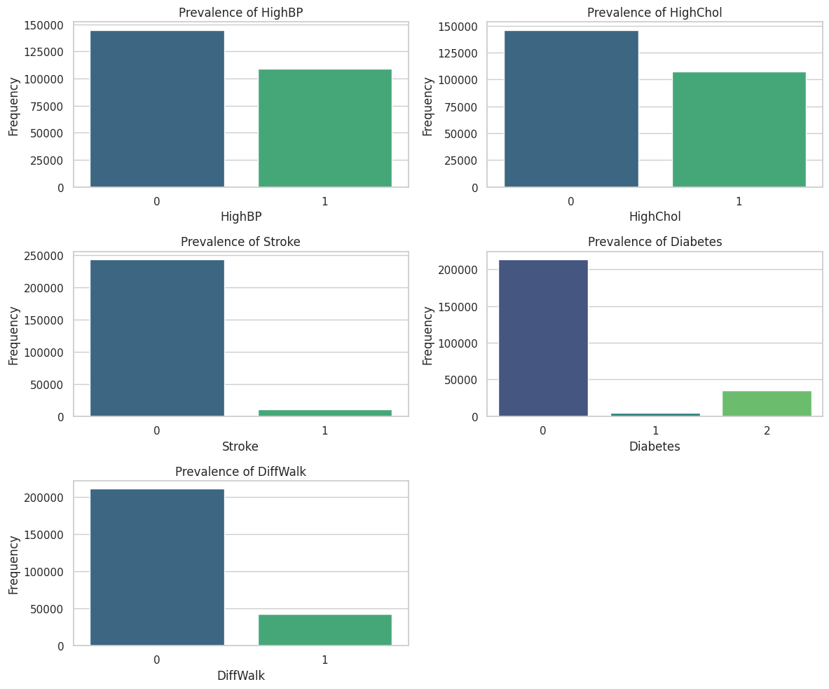
Investigate Prevalence of Health Conditions

Slide 18
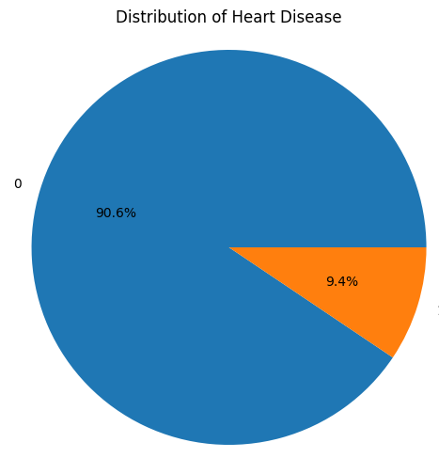
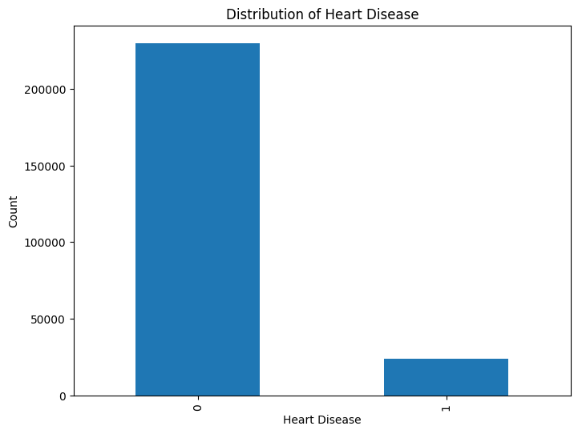
Analyze Distribution of Heart Disease (Target Variable)
Heart disease affects around 9.4% of the population in the dataset.
This suggests that while heart disease is a critical condition, the majority of individuals (about 90.6%) do not report having heart disease.

Slide 19

Bivariate analysis
Explore Relationships with Heart Disease
Visualize Correlations Between Variables
Compare Heart Disease Across Demographic Groups

Slide 20
Compare the distribution of key variables between individuals with and without heart disease.
Explore Relationships with Heart Disease
Key variables considered are
High Blood Pressure
High Cholesterol
Smoking
Stroke
Body Mass Index

Slide 21

Explore Relationships with Heart Disease

Slide 22
Explore Relationships with Heart Disease
High Blood Pressure:
High blood pressure is significantly more prevalent among individuals with heart disease (75.03%) compared to those without (39.56%).
The Chi-square test indicates a strong association between high blood pressure and heart disease, meaning individuals with high blood pressure are at a much higher risk of developing heart disease.
2. High Cholesterol
High cholesterol is also much more prevalent in individuals with heart disease compared to those without.
The strong statistical association (p-value = 0.0) suggests that high cholesterol is a significant risk factor for heart disease.
3. Smoking:
Smoking is notably more common among individuals with heart disease than those without.
The association is statistically significant, reinforcing that smoking is a major risk factor for heart disease.

Slide 23
Compare the distribution of key variables between individuals with and without heart disease.
4. Stroke
Stroke is strongly associated with heart disease.
Individuals who have suffered a stroke are at a greater risk for heart disease.
5. Body Mass Index
The extremely low p-value for BMI suggests a very strong relationship between BMI and heart disease.
This implies that BMI is a significant risk factor, and individuals with higher BMI are more likely to suffer from heart disease.

Slide 24
Compare the distribution of key variables between individuals with and without heart disease.
4. Stroke
Stroke is strongly associated with heart disease.
Individuals who have suffered a stroke are at a greater risk for heart disease.
5. Body Mass Index
The extremely low p-value for BMI suggests a very strong relationship between BMI and heart disease.
This implies that BMI is a significant risk factor, and individuals with higher BMI are more likely to suffer from heart disease.

Slide 25
Compare the distribution of key variables between individuals with and without heart disease.
4. Stroke
Stroke is strongly associated with heart disease.
Individuals who have suffered a stroke are at a greater risk for heart disease.
5. Body Mass Index
The extremely low p-value for BMI suggests a very strong relationship between BMI and heart disease.
This implies that BMI is a significant risk factor, and individuals with higher BMI are more likely to suffer from heart disease.

Slide 26
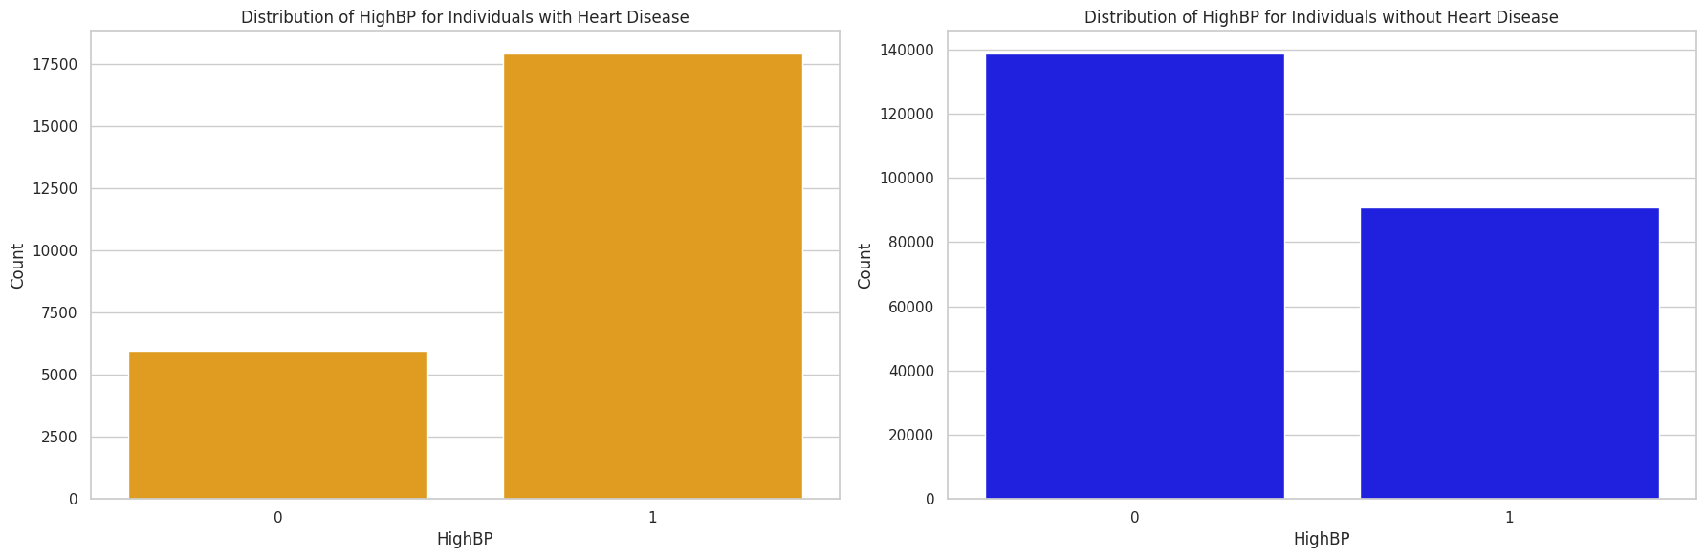
DISTRIBUTION OF
HIGH Blood pressure of
individuals WITH AND
WITHOUT HEART DISEASE.
Individuals with Heart Disease
1 | 17928
0 | 5965
Individuals without Heart Disease
0 | 17928
1 | 5965
A significantly higher proportion of individuals with heart disease suffer from high blood pressure, suggesting it is a strong risk factor for heart disease.

Slide 27
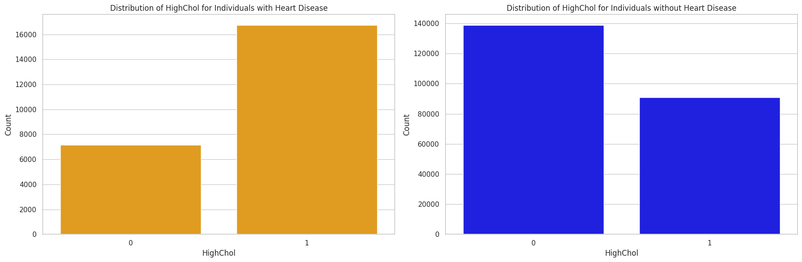
DISTRIBUTION OF
HIGH CHOLESTEROL of
Individuals WITH AND
WITHOUT HEART DISEASE.
Individuals with Heart Disease
1 | 16753
0 | 7140
Individuals without Heart Disease
0 | 138949
1 | 90838
High cholesterol is more prevalent among those with heart disease, highlighting it as another important risk factor.

Slide 28
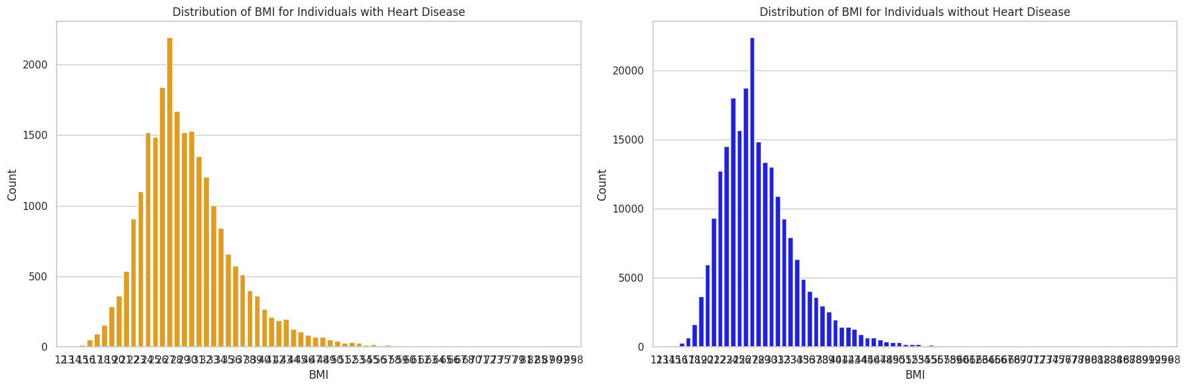
DISTRIBUTION OF
bmi of individuals WITH
AND WITHOUT HEART DISEASE.
While the distribution of BMI is similar between the two groups, slightly higher BMI values may indicate an increased risk of heart disease.

Slide 29
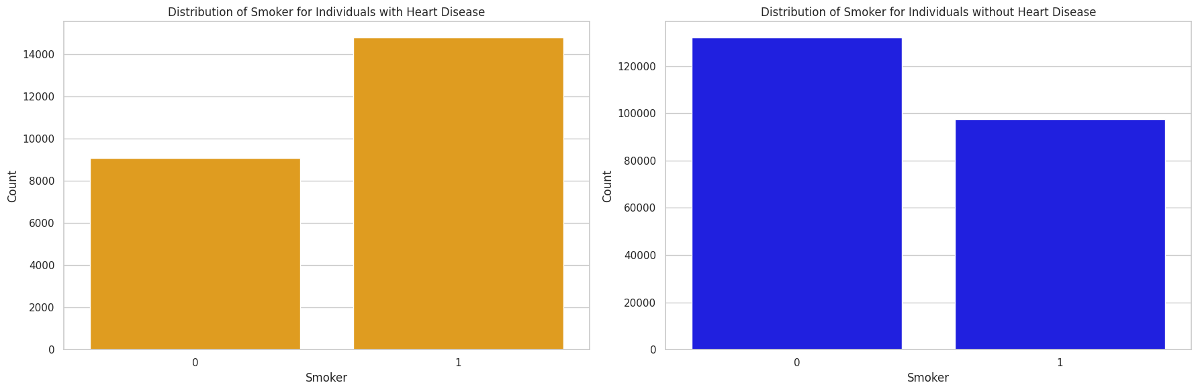
DISTRIBUTION OF
Smoking level of
individuals WITH AND
WITHOUT HEART DISEASE.
Individuals with Heart Disease
1 | 14801
0 | 9092
Individuals without Heart Disease
0 | 132165
1 | 97622
Smoking is much more common among individuals with heart disease, reinforcing its known association with cardiovascular risk.

Slide 30
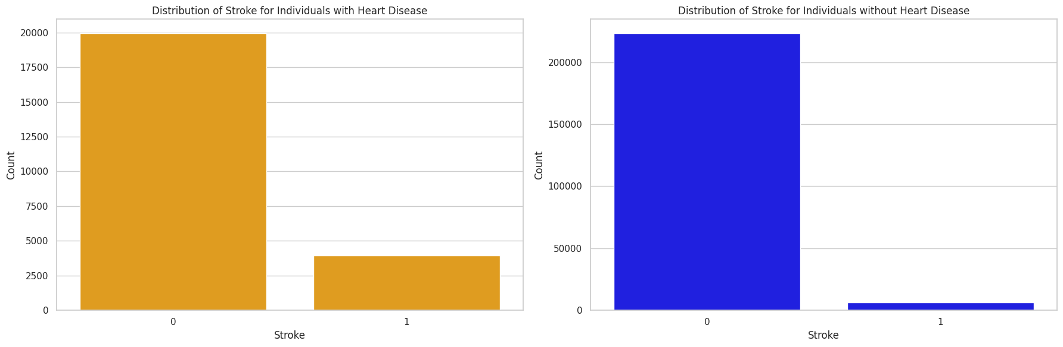
DISTRIBUTION for
Stroke of individuals
WITH AND WITHOUT
HEART DISEASE.
Individuals with Heart Disease
1 | 19956
0 | 3937
Individuals without Heart Disease
0 | 223432
1 | 6355
Stroke is strongly associated with heart disease, indicating a significant overlap between the two conditions.

Slide 31
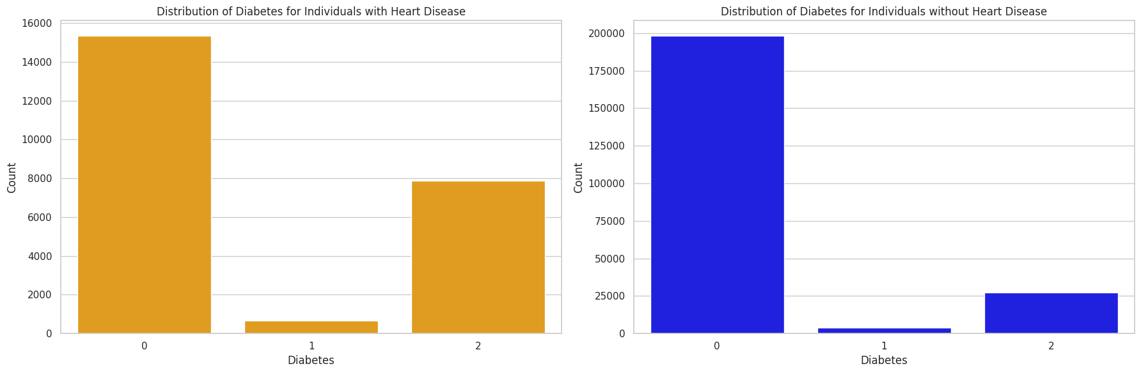
DISTRIBUTION OF
HIGH Blood pressure of
individuals WITH AND
WITHOUT HEART DISEASE.
Individuals with Heart Disease
0 | 15351
1 | 664
2 | 7878
Individuals without Heart Disease
0 | 198352
1 | 3967
2 | 27468
Diabetes, especially type 2, is more common in individuals with heart disease, reinforcing its role as a risk factor.

Slide 32
Visualize Correlations Between Variables
First we will explore which features are categorical or continuous data types.
Then we plot Scatter Plot.
Lastly we explore correlation matrices.

Slide 33
Visualize Correlations Between Variables
Identify whether each feature is a categorical variable or a numerical variable
Feature | Data Type
HeartDiseaseorAttack | category
HighBP | category
HighChol | category
CholCheck | category
BMI | int64
Smoker | category
Stroke | category
Diabetes | category
PhysActivity | category
Fruits | category
Veggies | category
Feature | Data Type
HvyAlcoholConsump | category
AnyHealthcare | category
NoDocbcCost | category
GenHlth | int64
MentHlth | int64
PhysHlth | int64
DiffWalk | category
Sex | category
Age | int64
Education | category
Income | category
Thus, the continuous variables are:
BMI
GenHlth
MentHlth
PhysHlth
Age

Slide 34
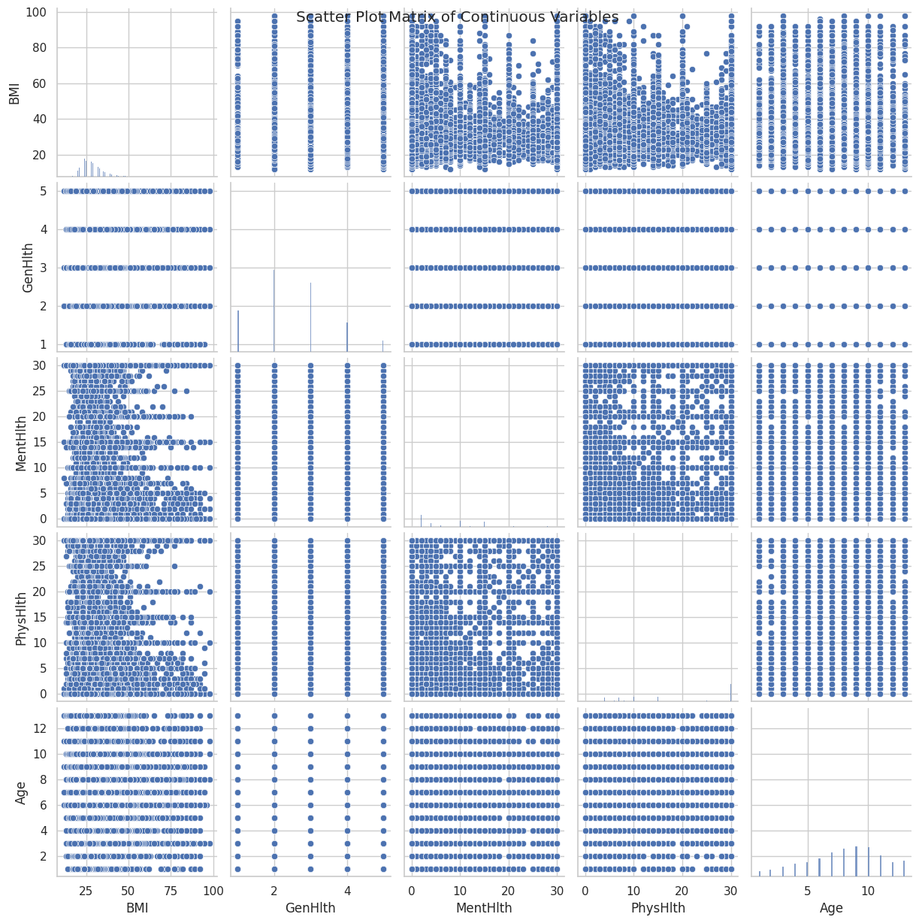
Scatter Plot

Slide 35
Scatter Plot
BMI, GenHlth: There appears to be a slight positive correlation. As BMI increases, GenHlth scores tend to increase, indicating poorer general health for those with higher BMI.
BMI, MentHlth: A weak positive correlation is visible. Higher BMI values are associated with slightly more days of poor mental health, though the relationship isn't strong.
BMI, PhysHlth: Similar to mental health, there's a weak positive correlation. Individuals with higher BMI tend to report slightly more days of poor physical health.
BMI, Age: There's a slight positive correlation. BMI tends to increase somewhat with age, though the relationship isn't very strong.
GenHlth, MentHlth: A moderate positive correlation exists. As GenHlth scores increase indicating poorer general health, the number of poor mental health days also tends to increase.
GenHlth, PhysHlth: A strong positive correlation is evident. Higher GenHlth scores poorer general health are strongly associated with more days of poor physical health.
GenHlth, Age: There's a weak positive correlation. General health tends to decline slightly higher GenHlth scores as age increases.
MentHlth, PhysHlth: A strong positive correlation is visible. More days of poor mental health are strongly associated with more days of poor physical health, suggesting a close relationship between mental and physical well-being.
MentHlth, Age: A very weak positive correlation exists. There's a slight tendency for older individuals to report more days of poor mental health, but the relationship is not strong.
PhysHlth, Age: Similar to mental health, there's a weak positive correlation with age. Older individuals tend to report slightly more days of poor physical health, but the relationship isn't strong

Slide 36
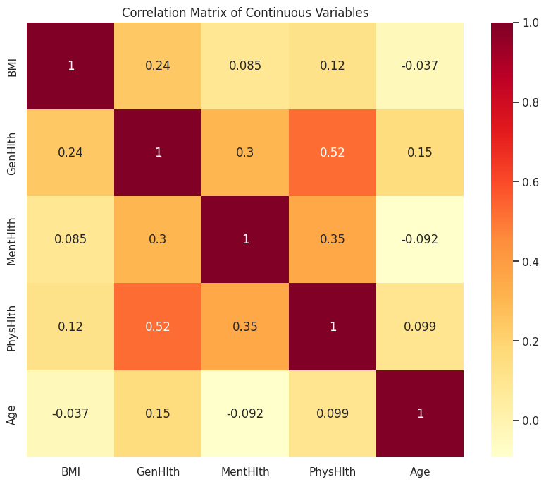
CORRELATION PLOT

Slide 37
Correlation plot
1. GenHlth vs PhysHlth:
(1) The strongest positive correlation is observed between GenHlth (General Health) and PhysHlth (Physical Health), with a value of 0.52.
(2) This suggests that individuals who report poorer general health also tend to report a greater number of days of poor physical health. 2. GenHlth vs MentHlth:
(1) There is a moderate positive correlation (0.30) between GenHlth and MentHlth (Mental Health).
(2) This indicates that individuals with poorer general health tend to report more days of poor mental health as well. 3. PhysHlth vs MentHlth:
(1) A moderate positive correlation (0.35) is seen between PhysHlth and MentHlth.
(2) This suggests that individuals who experience more days of poor physical health are likely to also report more days of poor mental health.

Slide 38
Correlation plot
4. BMI vs GenHlth
(1) BMI has weak positive correlations with GenHlth (0.24) and PhysHlth (0.12), implying that individuals with higher BMI tend to report slightly worse general and physical health, but the relationship is not very strong. 5. BMI vs MentHlth
(1) The correlation between BMI and MentHlth is extremely weak (0.085), indicating very little relationship between BMI and mental health. 6. BMI vs Age
(1) BMI has a weak negative correlation with Age (-0.037), suggesting no significant relationship between these two variables. 7. Age
(1) Age shows weak or no meaningful correlations with other variables.
(2) The highest is with GenHlth (0.15), indicating a slight tendency for older individuals to report worse general health, but this relationship is not strong.

Slide 39
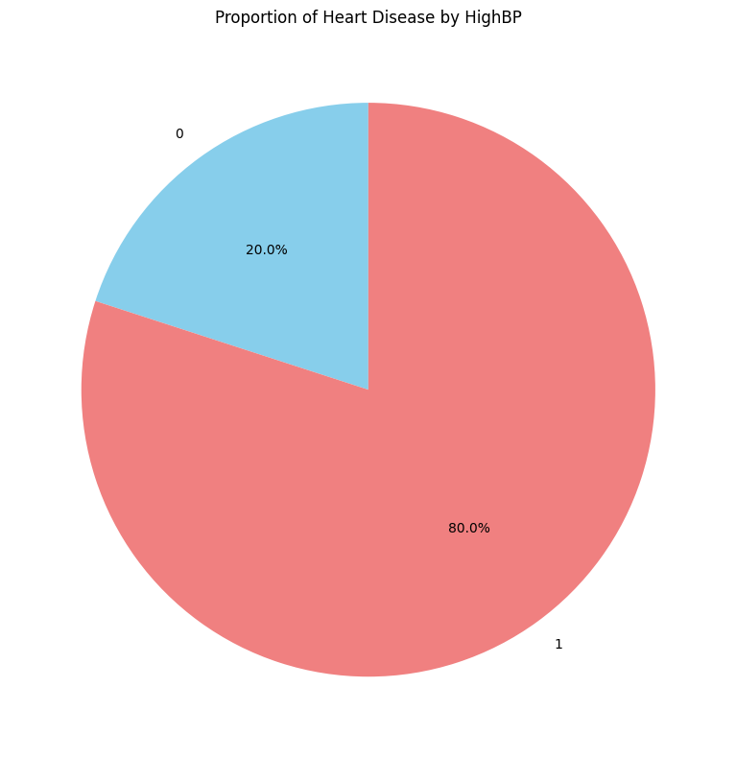
Compare Heart Disease Across Demographic Groups
Individuals with high blood pressure have a significantly higher prevalence of heart disease compared to those without high blood pressure.
This suggests a strong association between high blood pressure and heart disease.

Slide 40
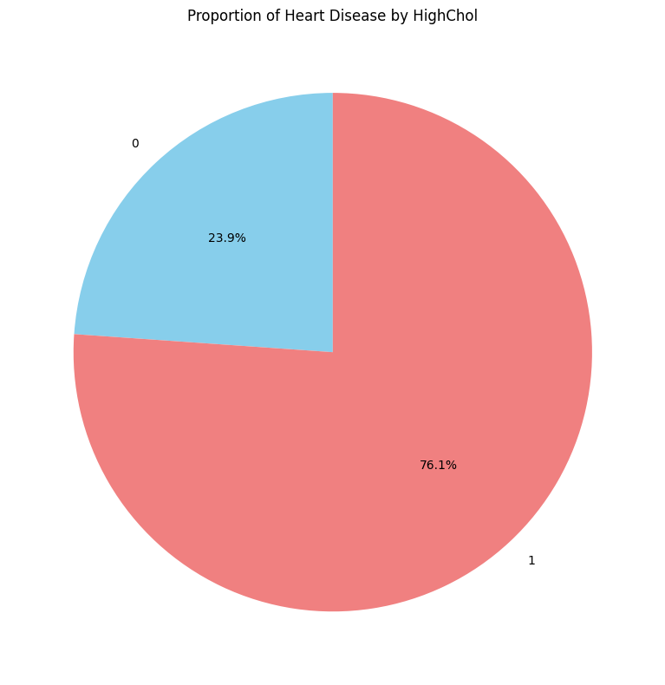
Compare Heart Disease Across Demographic Groups
Individuals with high cholesterol show a higher prevalence of heart disease (16%) compared to those without (5%).
High cholesterol is another significant risk factor for heart disease.

Slide 41
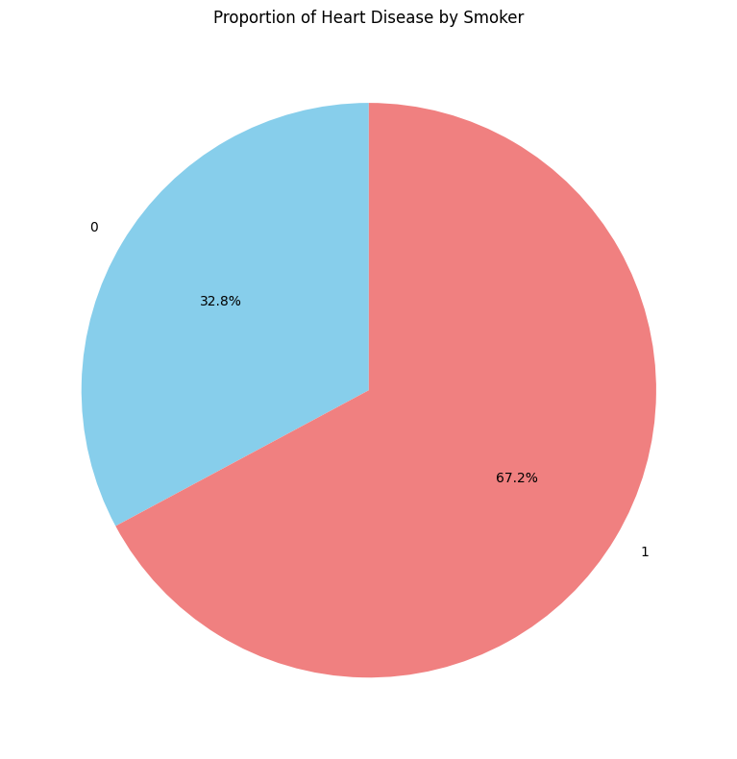
Compare Heart Disease Across Demographic Groups
Smokers have a higher prevalence of heart disease (13%) compared to non-smokers (6%).
This suggests that smoking is a considerable risk factor for developing heart disease.

Slide 42
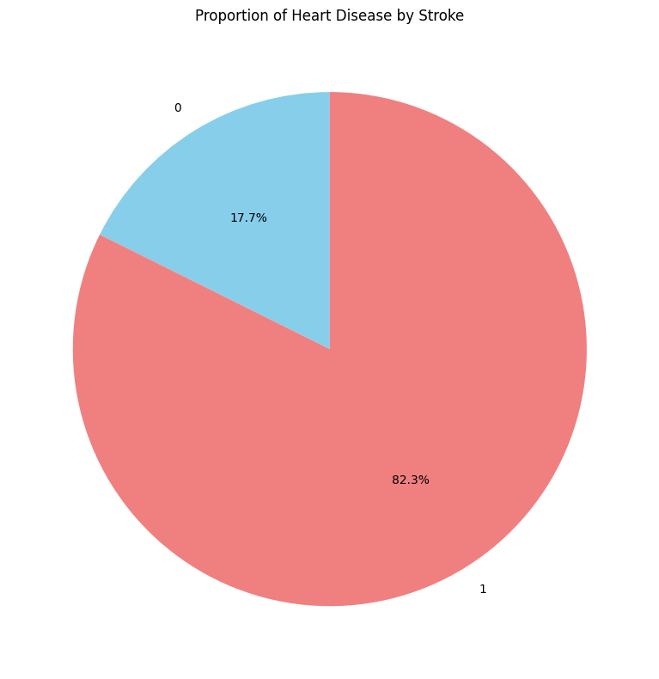
Compare Heart Disease Across Demographic Groups
Individuals who have had a stroke have a notably high prevalence of heart disease (38%), compared to only 8% among those without a history of stroke.
A history of stroke is a major risk factor for heart disease.

Slide 43
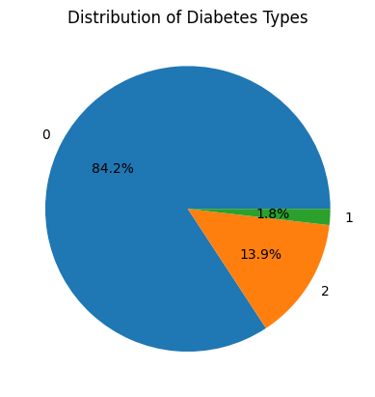
Compare Heart Disease Across Demographic Groups
Individuals with Type 1 or Type 2 diabetes have a higher prevalence of heart disease (14% and 22%, respectively) compared to non-diabetics (7%).
The risk of heart disease is particularly elevated for individuals with Type 2 diabetes.

Slide 44
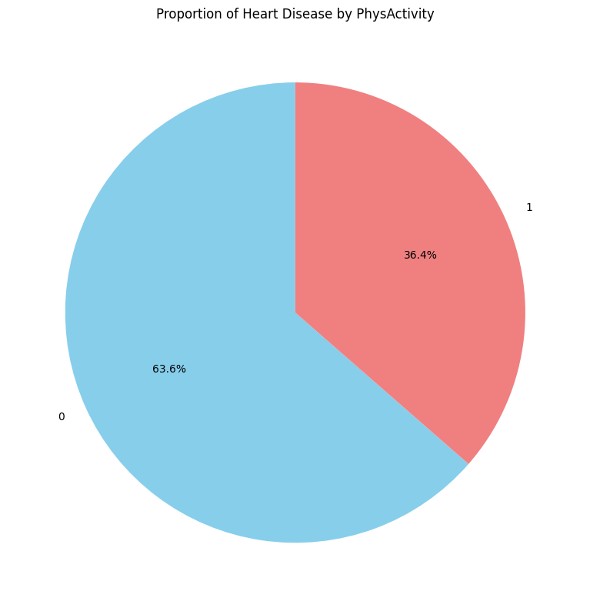
Compare Heart Disease Across Demographic Groups
Those who engage in physical activity have a lower prevalence of heart disease (8%) compared to those who are physically inactive (14%).
Physical activity appears to be a protective factor against heart disease.

Slide 45
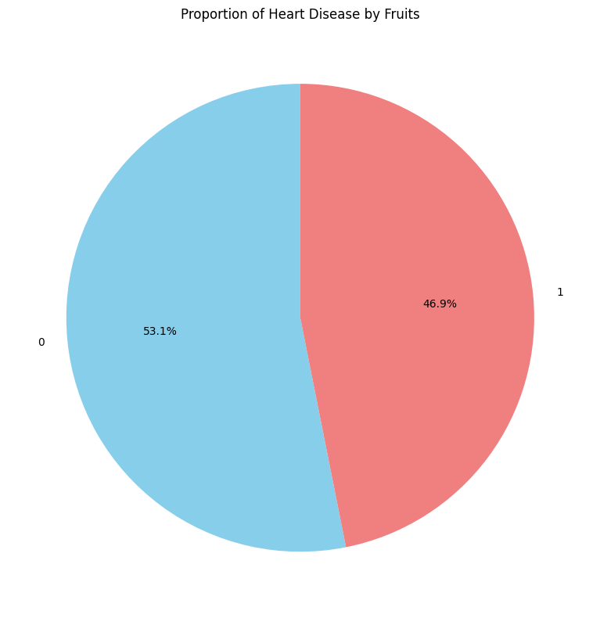
Compare Heart Disease Across Demographic Groups
People who consume fruits or vegetables have slightly lower heart disease prevalence (9%) compared to those who do not (10% and 12%, respectively).

Slide 46
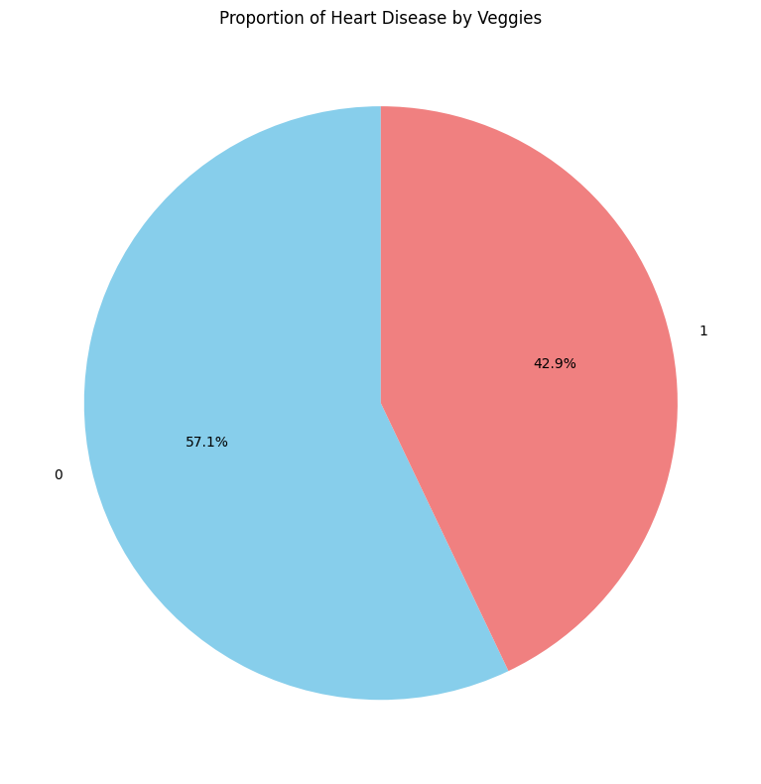
Compare Heart Disease Across Demographic Groups
While there is a small protective effect from fruit and vegetable consumption, the differences are modest.

Slide 47
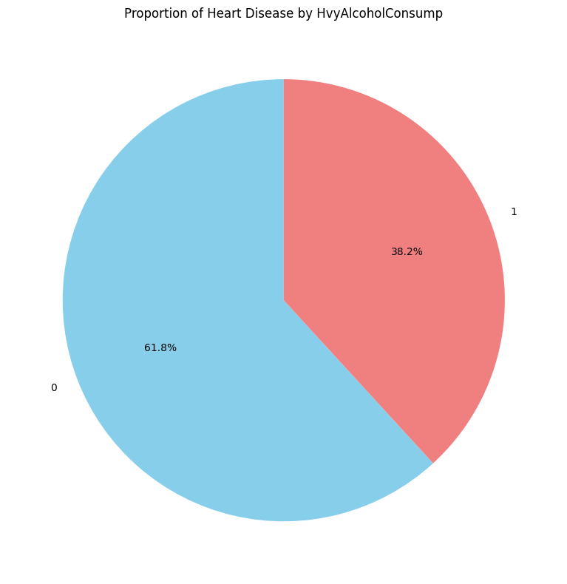
Compare Heart Disease Across Demographic Groups
Surprisingly, individuals who engage in heavy alcohol consumption have a lower prevalence of heart disease (6%) compared to non-heavy drinkers (10%).
This could reflect the protective effects of moderate alcohol consumption or other confounding factors.

Slide 48
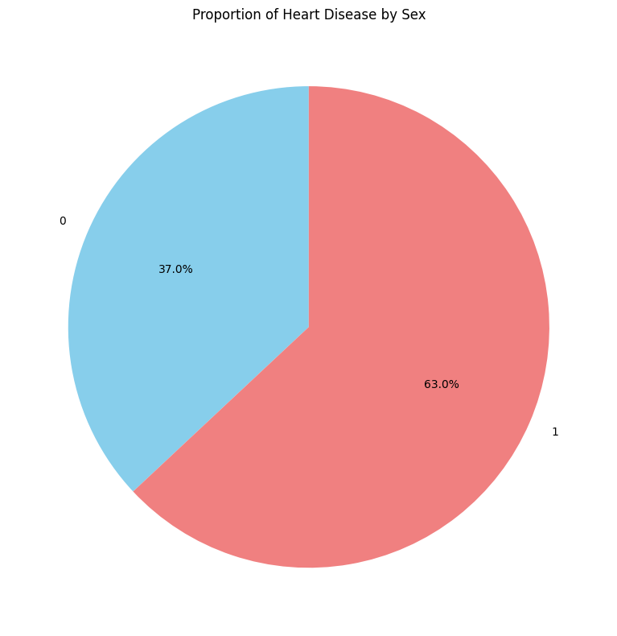
Compare Heart Disease Across Demographic Groups
Males have a higher prevalence of heart disease (12%) compared to females (7%).
This suggests that males are at a greater risk of heart disease

Slide 49
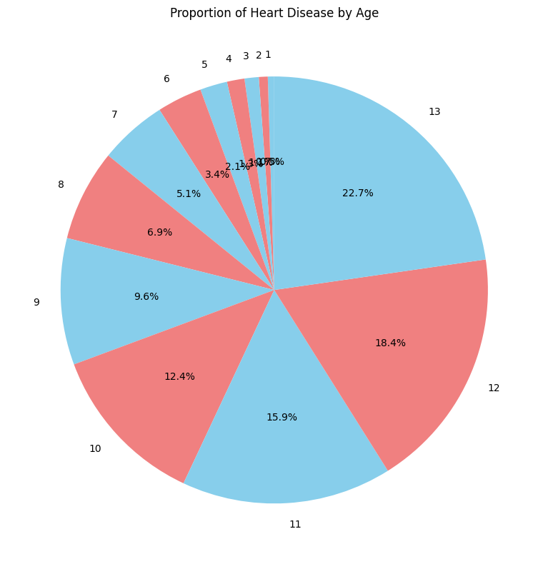
Compare Heart Disease Across Demographic Groups
Heart disease prevalence increases steadily with age.
Young individuals have very low heart disease prevalence, but the risk rises significantly in older age groups, reaching 24% in the oldest age category.
Age is a well-established risk factor for heart disease, as seen in this analysis.

Slide 50
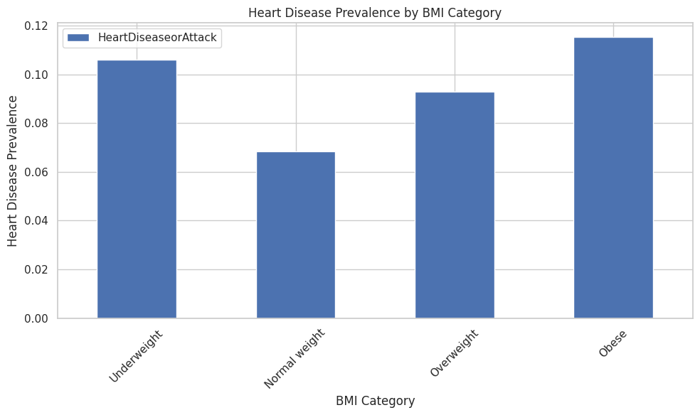
Compare Heart Disease Across Demographic Groups
Underweight people (BMI less than 18.5):
10.6% have heart disease.
This is surprisingly high, suggesting they might have other health problems.
2. Normal weight people (BMI 18.5 to 24.9):
Only 6.8% have heart disease.
This is the lowest rate, showing that a healthy weight is good for your heart.
3. Overweight people (BMI 25 to 29.9):
9.3% have heart disease.
This is higher than normal weight people, but not as high as obese or underweight people.
4. Obese people (BMI 30 or more):
11.5% have heart disease.
This is the highest rate, showing that being very overweight is bad for your heart.

Slide 51
Thank you

